Slide 1
301, Oct 29, Class 19
Responsible Conduct of Research
  Chapter 18
  Why we have new practices in scientific reporting related to rigorous research

Slide 2
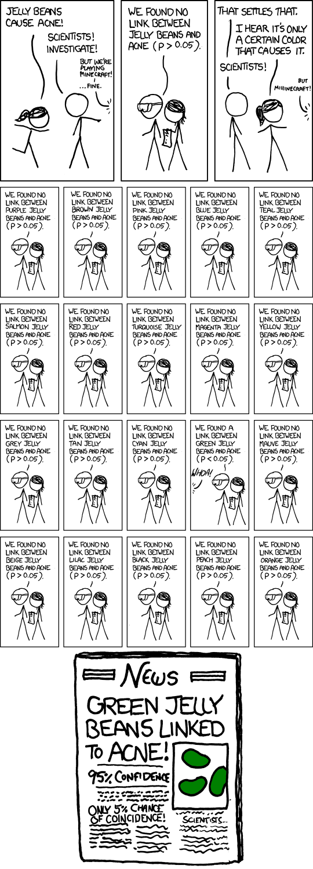

Slide 3
Vaccine skepticism
In 1998, Andrew Wakefield and 12 of his colleagues published a case series in the Lancet, which suggested that the measles, mumps, and rubella (MMR) vaccine may predispose to behavioral regression and pervasive developmental disorder in children.
Despite the small sample size (n=12), the uncontrolled design, and the speculative nature of the conclusions, the paper received wide publicity, and MMR vaccination rates began to drop because parents were concerned about the risk of autism after vaccination.

Slide 4
Taylor et al (1999) examined 498 cases of autism
  There was no difference in age at diagnosis between the cases vaccinated before or after 18 months of age and those never vaccinated.
  There was no temporal association between onset of autism within 1 or 2 years after vaccination with MMR (relative incidence compared with control period 0.94 [95% CI 0.60-1.47] and 1.09 [0.79-1.52]).
Lancet (2004) reviewed allegations against Wakefield
  Acknowledged that Wakefield had a significant “conflict of interest”
  Dismissed allegations of improper recruiting, patient selection

Slide 5
Full Investigation
Wakefield was paid over £400k by lawyers trying to sue vaccine companies in the two years before the study
  Had already asserted a vaccine/bowel/autism link before data were collected
  Written communication asked him to find a “temporal link”
Analysis of the 12 patients revealed none matched their actual medical records
  Patients mostly knew each other and were recruited due to vaccine concerns and were pre-interviewed for consistency with the hypothesis before enrolling in study
  Several had documented symptoms pre-dating vaccination (developmental delays and/or GI problems)
  Data linking the time from vaccination to diagnosis were incorrect, inconsistent data were excluded
Full retraction of the paper from Lancet in 2010
  Wakefield lost medical license

Slide 6
Research Integrity
Brian Deer, journalist, did most of the investigation uncovering the research fraud
  Funded by the Sunday Times of London and the Channel 4 television network.
  Reports by Deer in the BMJ were commissioned and paid for by the journal.
  No other funding was received, apart from legal costs paid to Deer by the Medical Protection Society on behalf of Andrew Wakefield.
  All claims in Deer’s articles consistent with investigation from the British General Medical Counsel assessed by editors at the British Medical Journal
Took 12 years to investigate, find fraud and retract paper

Slide 7
Responsible Conduct of Research
Researchers carry out research process with rigor and integrity
  Don’t lie, cheat or steal
Improper handling of research data
  Forgery: fabrication or modification
  Data selection
    Excluding data inconsistent with the hypothesis
  Bias in recruiting, protocol administration or data scoring
    Processes not accurately described in reporting

Slide 8
Scientific Misconduct
Data fabrication
  Wholesale invention of data never collected from participants
Data manipulation
  Excluding participants whose data is inconsistent with the hypothesis
  Modifying a subset of data
    Changing numbers, moving participants across groups
  Small changes can have a large effect on analysis
  Very hard to detect from standard reporting
Problems are usually identified based on reports from research team members

Slide 9
Examples in Psychological Science
Diedrik Stapel
  Wholesale data fabrication
  55 papers retracted
Marc Hauser
  Animal cognition researcher modified data to fit hypotheses
Karen Ruggiero
  Falsified/fabricated data
Francesca Gino
  “Evil genius? How dishonesty can lead to greater creativity”
  Suspected data modification

Slide 10
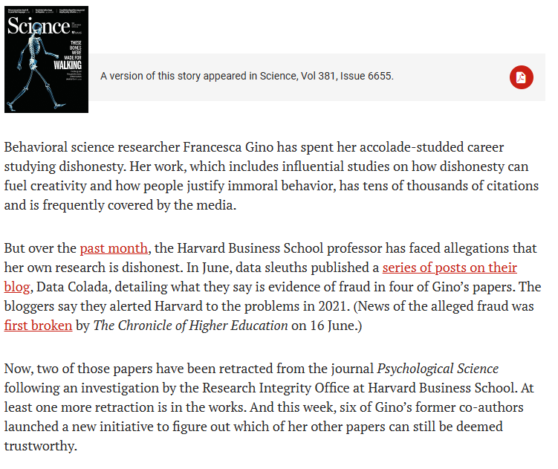
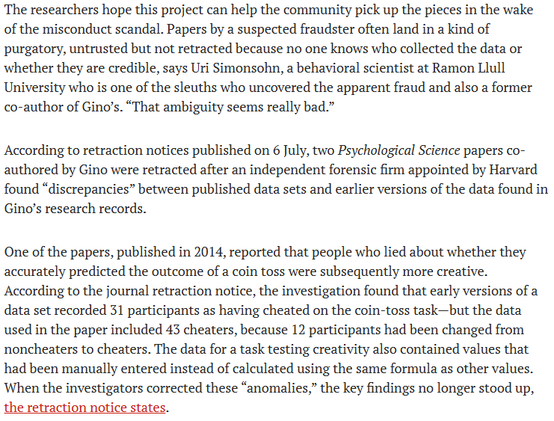

Slide 11
Office of Research Integrity
Oversight and investigation of suspected misconduct
  Scientists asked to carry out review and investigation
  Full respect for privacy of the researcher suspect
    Innocent until proven guilty
    Avoid damaging reputation
Sloppy research practices
  Participants excluded for “experimenter error”
  Inaccurate scoring, tracking
  No process is perfect, when does imperfection become misconduct

Slide 12
Transparency: Being Public
All aspects of the research process are auditable
  Participant privacy must still be protected
  Researchers protected from exposure to competing labs
  Patent, copyright, and invention privacy
Publication
  Full, fair & accurate reporting, making all resources available
    Not always practically effective
  Supplementary materials via journal website
  Public availability of de-identified data
    Does not always include excluded data

Slide 13
Plagiarism
Actual appropriation of others’ ideas is rare
Scientific progress is mostly using data to build on ideas
  Citations clarify and strengthen scientific reports
Authorial credit to collaborators and research team
  Significant intellectual contribution
  Definition varies across psychology, medicine for example
  Not uncommon source of in-laboratory friction
“Scooping” other research groups
  Multiple labs racing to complete a project for a high-profile publication

Slide 14
RCR Questions
Define each of the following forms of research misconduct: fabrication, falsification, and plagiarism. Provide an example of each.
A researcher selectively reports only the statistically significant results from a larger set of analyses. Is this considered misconduct or questionable research practice? Why?
What is a conflict of interest in research, and how should it be disclosed or managed? Give an example involving psychological research.

Slide 15
RCR Errors
Suppose a friend doing a research project said to you, “I’m sure my hypothesis is correct, so I’ll just give my participants a hint here and there to make sure the data come out properly.”
What kind of RCR violation is this?
What methodological approach should be used by this research to avoid this problem?

Slide 16
RCR Training
All research staff, including graduate students, are required to complete training for any grant-funded research
  Not necessarily because unethical researchers do not know what is unethical
  Creates a culture where responsible researchers notice if others are not
All researchers need a strong respect for data integrity
Specific practices differ across labs
  Rules for authorial credit on publications
  Collaboration policies
  Replication/pre-registration policies

Slide 17
Final Project: Collaborative Research
Work together on design, data collection, analysis
  Shared Methods & Results section
Work separately on Introduction, Discussion, Abstract
  Make your own figures
  Differing interpretations of the results are possible
  Each paper is your own (first author)
Academic integrity
  Building on other author’s ideas is not plagiarism, citations strengthen papers
  Taking other people’s words as your own is plagiarism
  Data fabrication is fraud

Slide 18
Planning for Final Proposal
Submit to us as if we are the IRB
  Present a full description of your protocol
    Motivating hypothesis
    Procedure as a draft of your Methods section
  All stimuli to be used
    Working version of an online survey including all conditions
No data collection until explicit approval
  Once approved, go as quickly as possible

Slide 19
Practical points
Design must be 2x2
  At least one factor must be manipulated across groups
  Randomly assigned
Minimal ethical risk to participants
  No personal/private information
  No deception other than blind to conditions
  No emotional manipulations
Build on existing research
  Add something new
Online data collection can be used
  Qualtrics: https://www.it.northwestern.edu/software/qualtrics/index.html

Slide 20
For Friday, 10/31
Reading #10, Stephens et al. (2009)
  Questions on Canvas
  Happy Halloween!

